Slide 1

Artificial Vision
Stereo Systems Master Degree in Computer Science
Fernando Marcelo Edelstein

Slide 2
Index
Stereo Vision in Nature
Camera Calibration
Stereo Vision
Uncalibrated Stereo
Homography

Slide 3
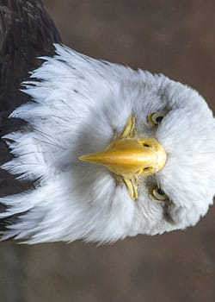

Stereo Vision in nature
Animal Stereo Vision
Taking a look at predators such as eagles or lions, we can appreciate that their eyes’ field of view overlaps due to their ability to look in detail at great distance. This overlapping FOV helps for hunting but also for environment perception
Preys on the other, usually present a wider FOV which often does not overlap between the eyes perception, allowing them to analyse the close environment.

Slide 4
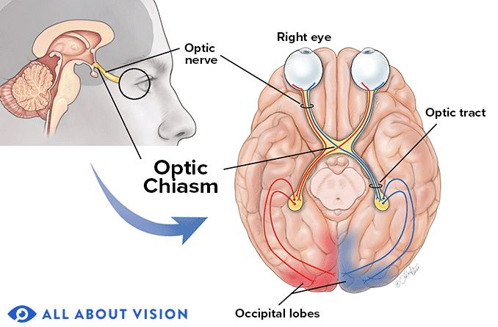
Stereo Vision in nature
Human Stereo Vision
When talking about human vision, the average distance between the eyes is 14mm. Human vision converges into a specific point with both eyes in order to properly look at some target.
Left side of the captured images goes to the left side of the brain and vice versa in order to produce stereo matching

Slide 5
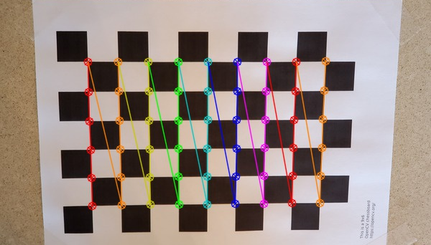
Camera Calibration
The calibration process consists in estimating the internal and external parameters of the camera in order to accurately project images from the 3D Coordinates to the 2D Plane or vice versa

Slide 6
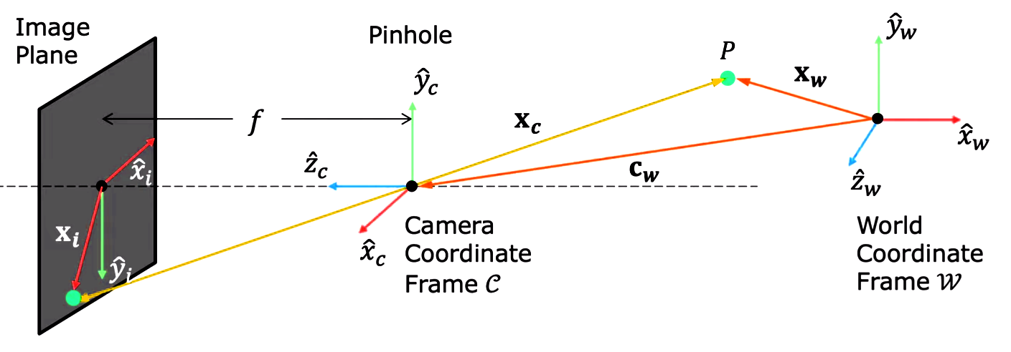
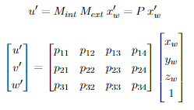
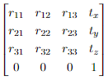
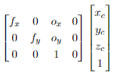
Camera Calibration
Intrinsic & Extrinsic Matrix
Extrinsic
Matrix
Intrinsic
Matrix
Projection
Matrix
There are basically two main components which are essential for estimating and reconstructing points in a scene either be in 2D or 3D, the Intrinsic and Extrinsic matrices, which their multiplication define the Projection Matrix.
The main idea behind this three concepts is that we can define a set of coordinates and a set of transformations that map a 3D point from the World Coordinate frame to the Camera Coordinate frame and then project it in 2D considering the current intrinsic matrix.

Slide 7
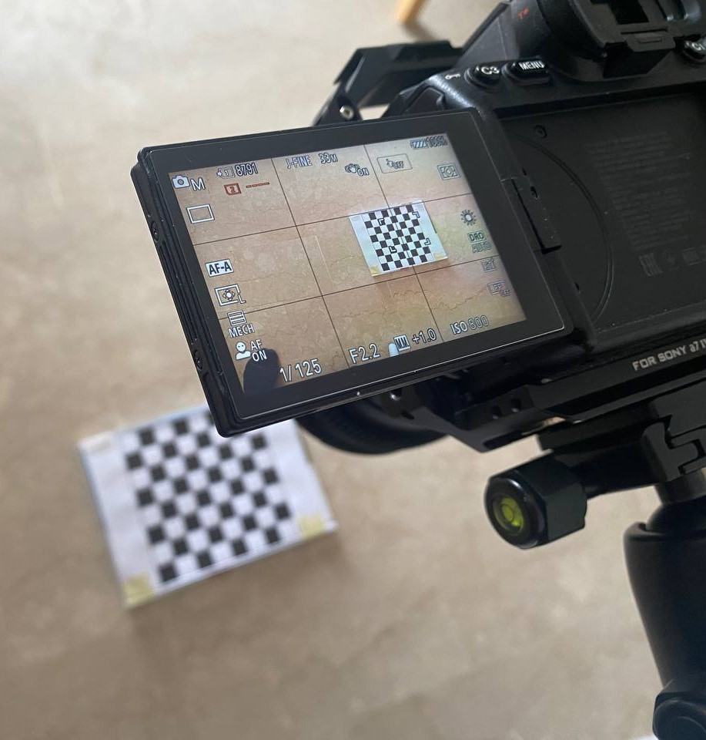
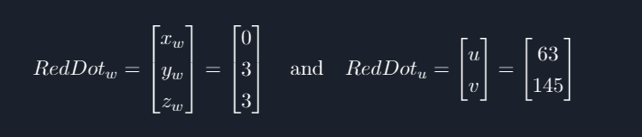
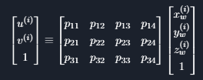
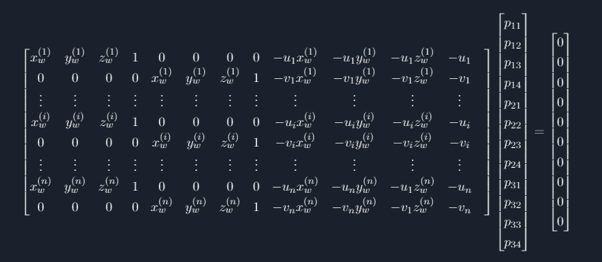
Calibration Process
01
Take some images of an object of known geometry
02
Find correspondences between the 3D scene points and the image points.
03
Plot the information from step 2 into the projection matrix equation
04
Rearrange the terms considering every point and solve for the Projection Matrix

Slide 8

Risultati
Camera Calibration
The code has been tested using a Sony a7IV which has a full frame sensor of 35.8 x 23.8mm combined with a Sigma art 24mm f1.4 lens which exhibits a noticeable amount of distortion, its field of view is 84.1 degrees and the settings used were:
Shutter speed: 1/125
Aperture: f 2.2
ISO: 800
Lens distortion correction: off
Lens chromatic aberration correction: off
Lens vignetting correction: off
File: JPG 33mpx downsampled to 1620x1080 (3:2 aspect ratio)

Slide 9
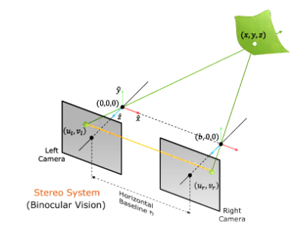
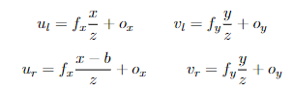
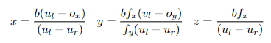
Stereo Vision
This system is composed by two identical cameras, they share the same intrinsic parameters and they are separated by a horizontal Baseline b.
A key element we have is the distance relation between cameras which is called Disparity. It is inversely proportional to the z depth and proportional to the Baseline, in other words, if a point is closer to the camera, the disparity is bigger and if a point is far away from the camera, the disparity is close to 0. On the other hand, a bigger Baseline will result on a bigger disparity.

Slide 10

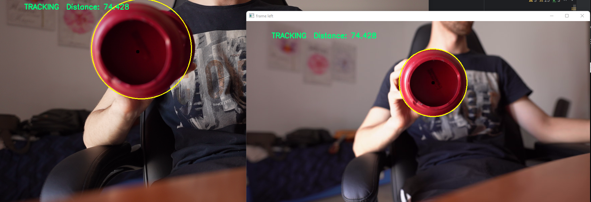
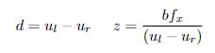
Stereo Vision
Triangulation
Triangulation in stereo vision refers to the process of determining the three-dimensional (3D) position of a point in space by analyzing the disparities (differences) in the visual information captured by two or more cameras or sensors observing the same point from different viewpoints.

Slide 11
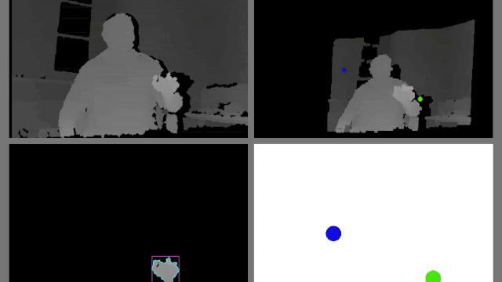
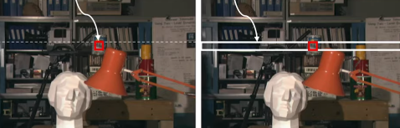
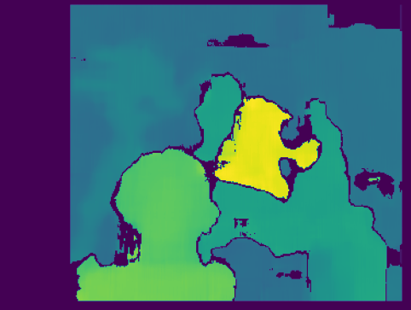
Stereo Vision
Depth Maps
Depth maps in stereo vision are 2D images that represent the spatial distribution of distances or depths of objects in a scene, obtained by analyzing the disparities between corresponding points in the images from two or more cameras observing the scene from different viewpoints.
stereo = cv.StereoBM_create(numDisparities=0, blockSize=19) Depth = stereo.compute(leftImage, rightImage)

Slide 12
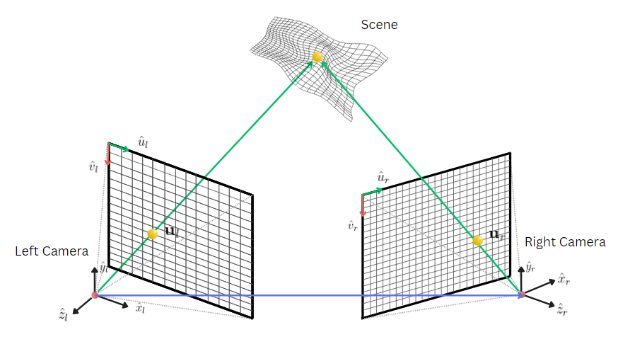
Uncalibrated Stereo
The main problem with stereo vision is the need for precise calibration of the stereo camera system, which involves accurately determining the intrinsic and extrinsic parameters, as well as requiring identical cameras for a proper computation
Uncalibrated stereo aims to recover the 3D structure of the scene and camera poses directly from the disparities and correspondences between image points. This approach is more robust in situations where precise calibration is difficult or impractical, however, it also results in less precise results.

Slide 13
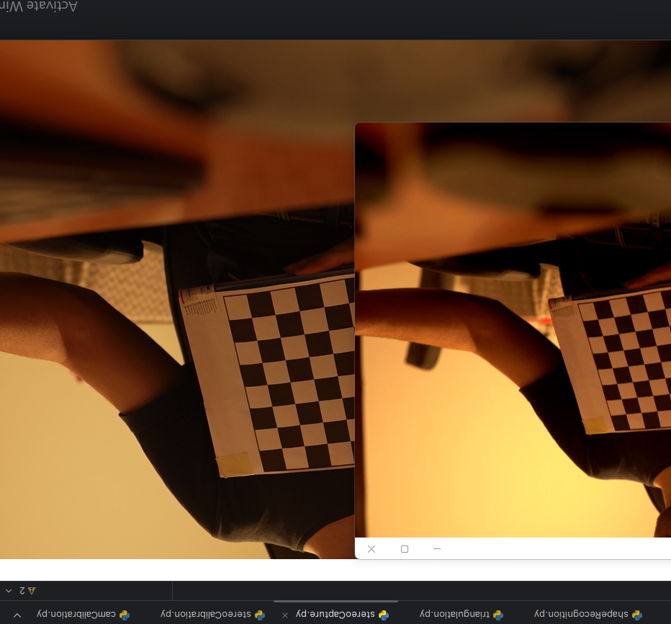
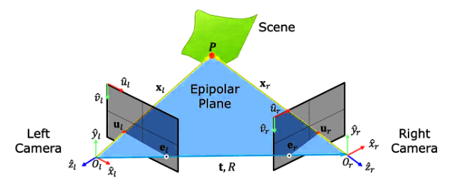
Uncalibrated Stereo
Epipolar Geometry
Epipolar geometry refers to the relationship between two cameras observing the same 3D scene constraining the search for corresponding points between the two images by defining the epipolar lines, which are the lines of intersection between the image planes and a plane in 3D space containing the baseline between the cameras.

Slide 14
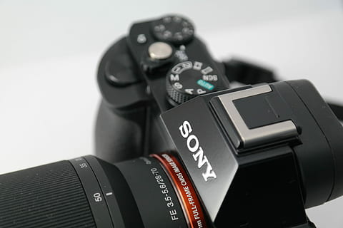
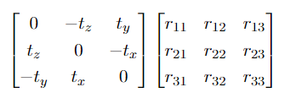
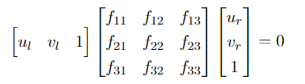
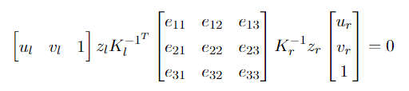
Uncalibrated Stereo
Essential & Fundamental Matrix
Essential Matrix
Fundamental
Matrix
The Essential matrix takes into account the relative pose (position and orientation) between two cameras. It is used to recover the 3D structure of a scene from correspondences between image points
The Fundamental matrix relates corresponding points in two camera images. It encodes the geometric constraints of how points in one image are projected onto the other image, it also helps with stereo rectification, point correspondence, and depth estimation

Slide 15
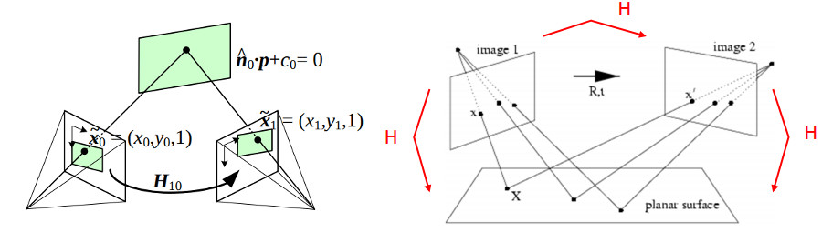
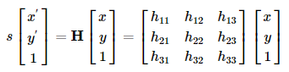
Homography
Homography is a 3x3 transformation matrix that describes the projective transformation between two images of the same scene taken from different viewpoints. It relates corresponding points in the images, allowing for rectification and depth estimation in stereo vision applications.

Slide 16
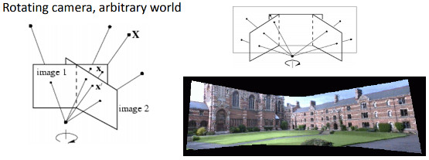
Homography
Use Cases
The homography matrix is a 3x3 matrix but with 8 DoF (degrees of freedom)
Examples
3D Reconstruction: Homographies help recover the 3D structure of a scene by mapping 2D image coordinates to 3D world coordinates.
Panorama Stitching: In creating panoramic images, homographies can be used to align and blend multiple images.
Camera Pose Estimation: Homographies assist in estimating the relative pose (position and orientation) of cameras in multi-camera systems.

Slide 17
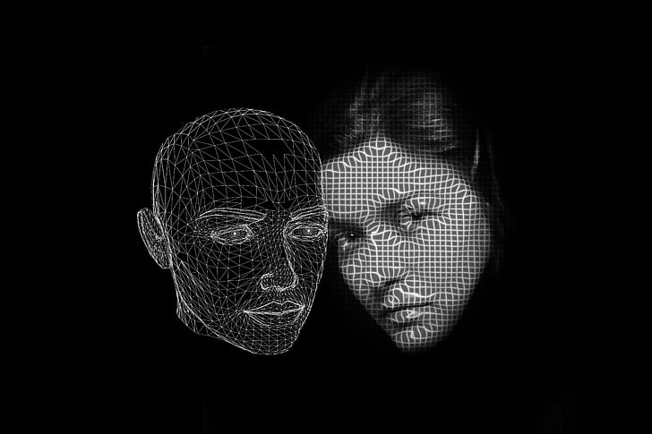
Homography
Mediapipe
MediaPipe's facial landmark model uses 468 landmark points for detecting and locating various facial features on a human face which create a representation of the facial geometry, allowing for tracking of facial expressions, movements, and features.
This task uses machine learning (ML) models that can work with single images or a continuous stream of images. The task outputs 3-dimensional face landmarks, blendshape scores (coefficients representing facial expression)
- https://developers.google.com/mediapipe

Slide 18
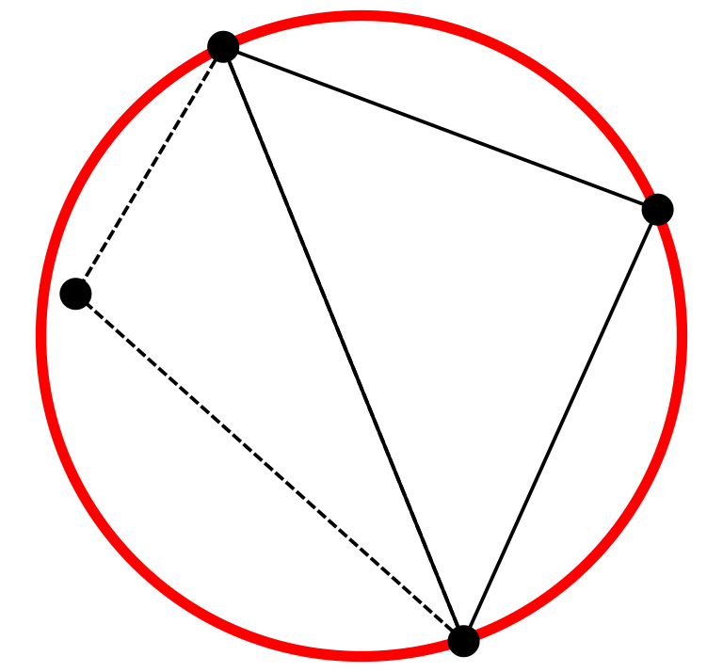
Homography
Delaunay Triangulation
Delaunay triangulation is a computational geometry technique used to divide a set of points (or a point cloud) into non-overlapping triangles in such a way that no point falls inside the circumcircle of any triangle maximising the minimum angle of all the triangles, which helps maintain the quality and efficiency of geometric computations.
The method used is the one provided by OpenCV, in this case, delaunay vector contains the set of the triangles coordinates of the provided face landmarks.

Slide 19

Homography
Warping and blending
A common technique used in face masking is warping one triangle from img1 and blend it onto another triangle in img2. A specific function was written to do so: WarpTriangles and ApplyAffineTransformation which applies the actual transformation
Next, the alpha blending consists sums the two images, the warped image mask and the target mask with alpha. Each triangle is warped and then the mask of the target face is calculated to be applied it in the actual_img, making the alpha blending

Slide 20
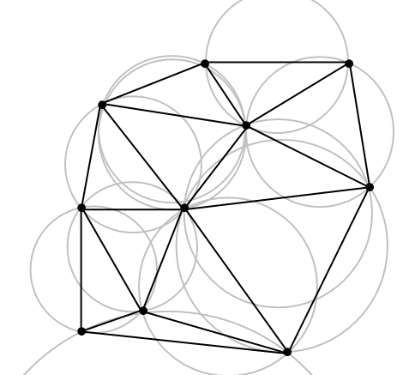
Homography
Homography and Perspective
For calculating the homography of the two faces, there is an OpenCV findHomography method, which takes two sets of landmarks to create the homography itself
The Homography is applied using the method warpPerspective.

Slide 21
Thank you!
Stereo Systems Master Degree in Computer Science Fernando Marcelo Edelstein

